Slide 1
Introduction
What is OpenMP
Open specifications for Multi Processing
Long version: Open specifications for MultiProcessing via collaborative work between interested parties from the hardware and software industry, government and academia.
OpenMP (Open Multi-Processing) is an application programming interface (API) that supports multi-platform shared memory multiprocessing programming in C, C++, and Fortran.
API components:
– Compiler directives
– Runtime library routines
– Environment variables
Portability
– API is specified for C/C++ and Fortran
– Implementations on almost all platforms including Unix/Linux and Windows.
– OpenMP is used for parallelism within a (multi-core) node while MPI is used for parallelism between nodes.
Standardization
– Jointly defined and endorsed by major computer hardware and software vendors.
Notes:
https://www3.nd.edu/~zxu2/acms60212-40212-S12/Lec-11-01.pdf

Slide 2
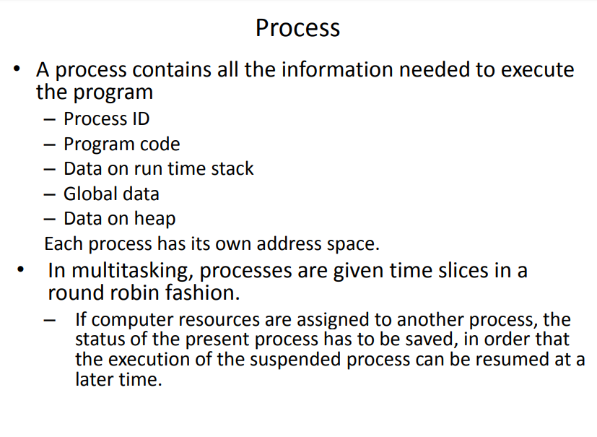

Slide 3
Thread
What is Thread
A process is an instance of a computer program that is being executed. It contains the program code and its current activity.
A thread of execution is the smallest unit of processing that can be scheduled by an operating system.
Differences between threads and processes:
A thread is contained inside a process.
Multiple threads can exist within the same process and share resources such as memory.
The threads of a process share the latter’s instructions (code) and its context (values that
its variables reference at any given moment).
Different processes do not share these resources.
Notes:
https://www3.nd.edu/~zxu2/acms60212-40212-S12/Lec-11-01.pdf
http://en.wikipedia.org/wiki/Process_(computing)

Slide 4
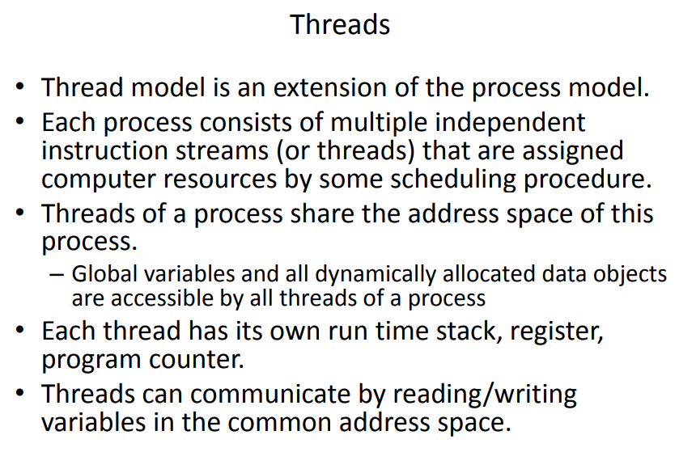

Slide 5
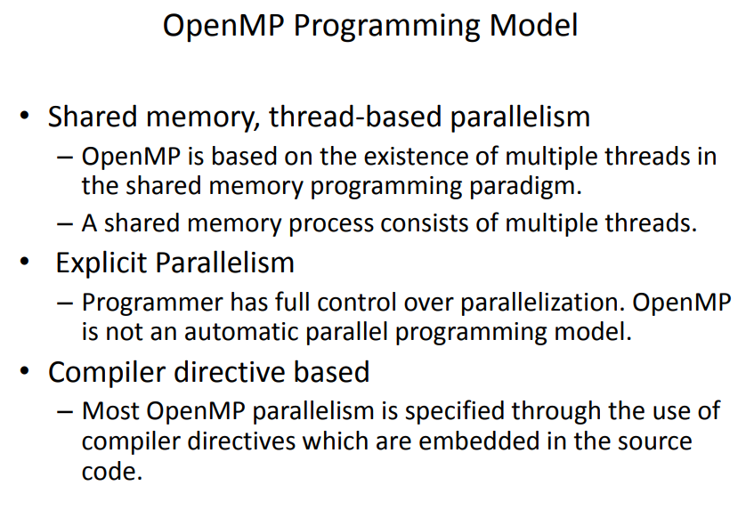

Slide 6
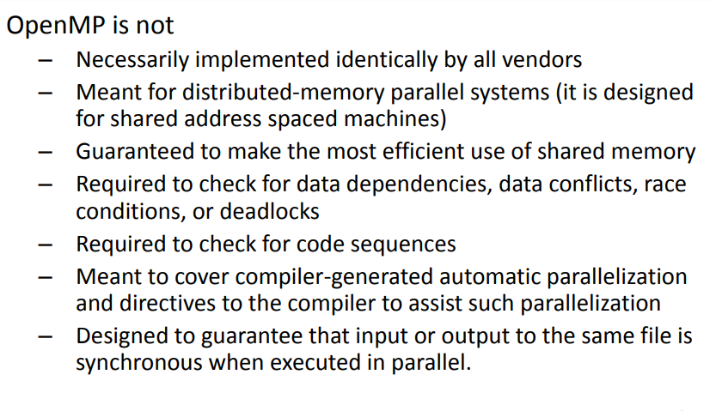

Slide 7
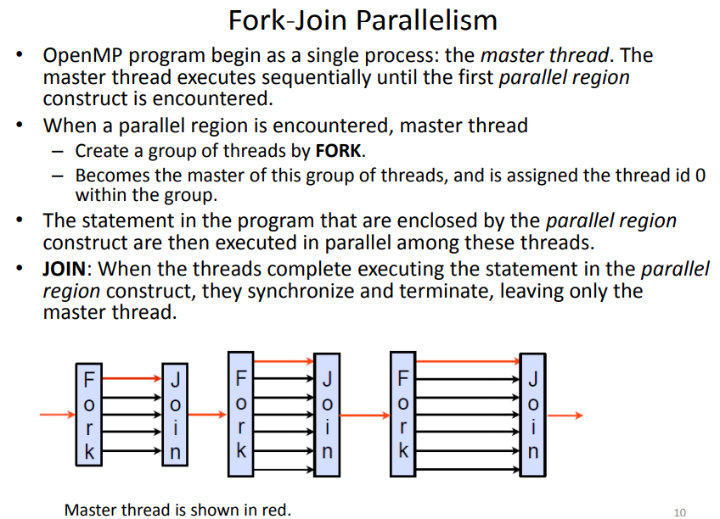

Slide 8
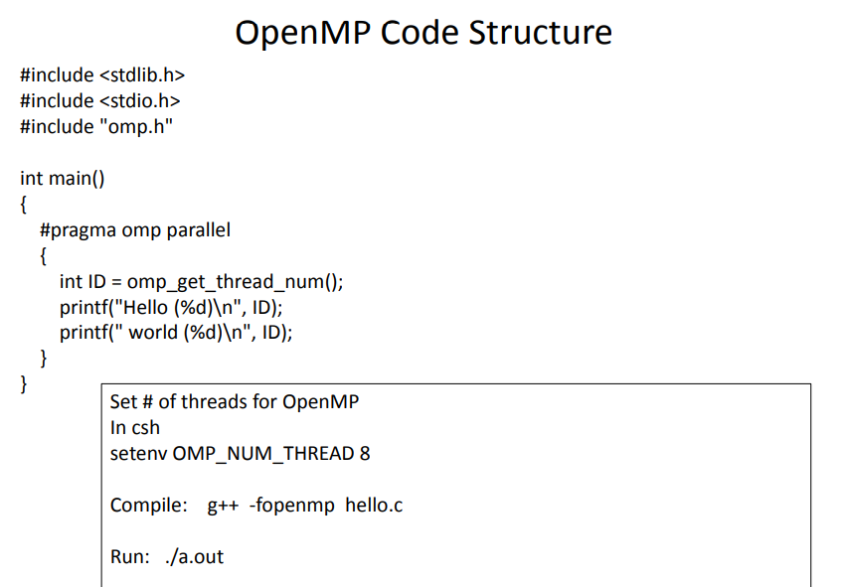

Slide 9
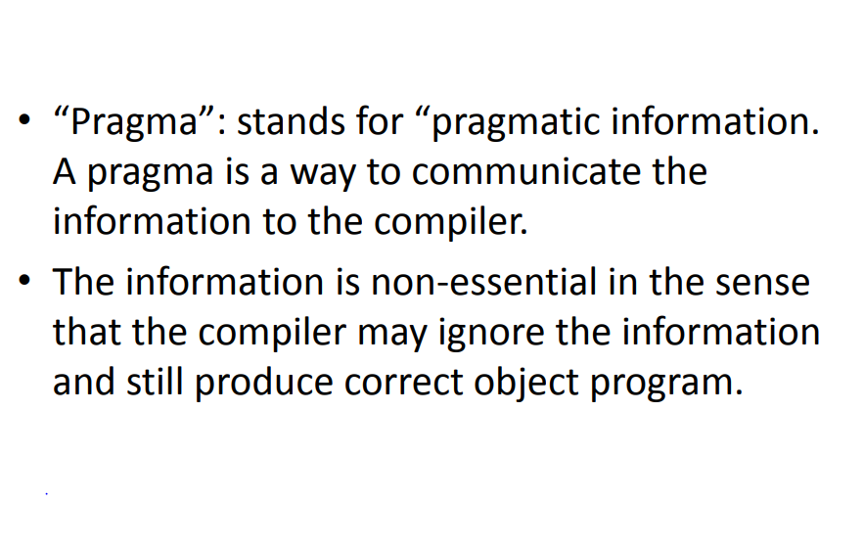

Slide 10
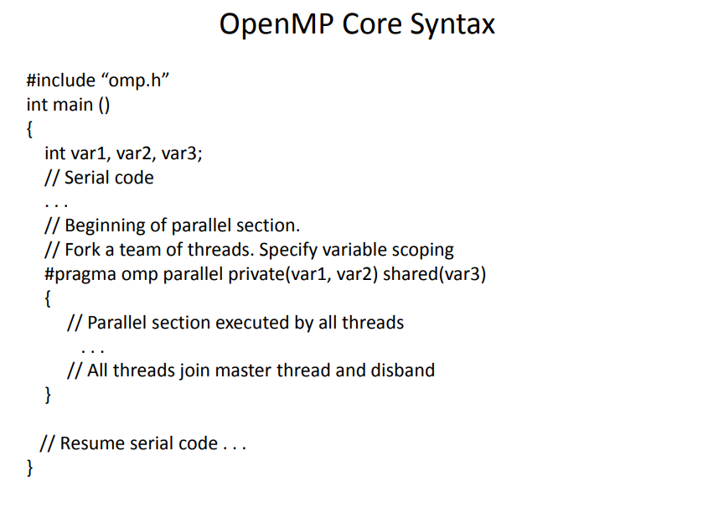

Slide 11
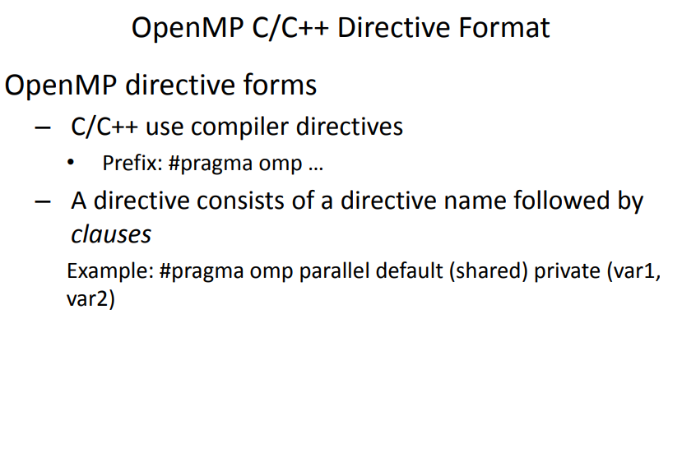

Slide 12
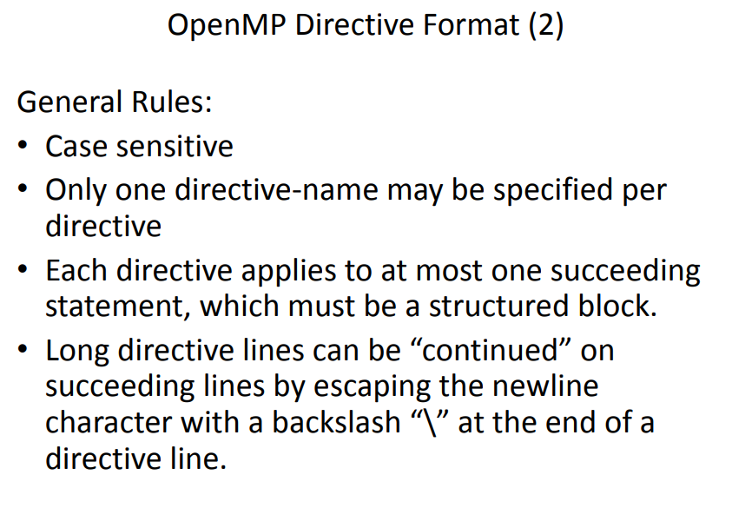

Slide 13
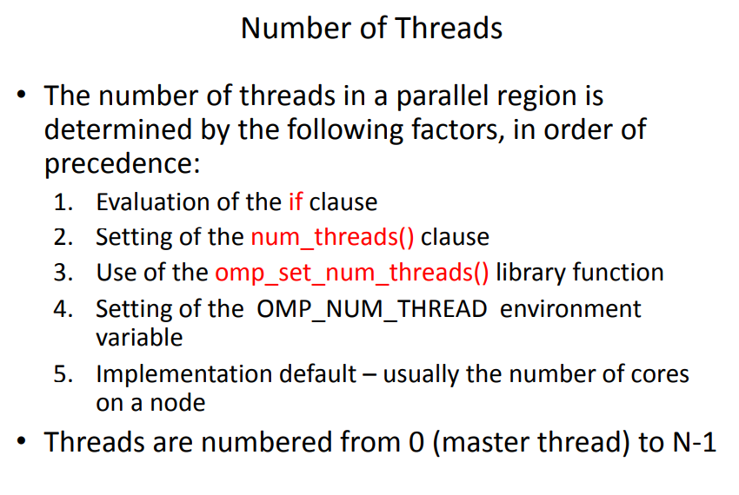

Slide 14
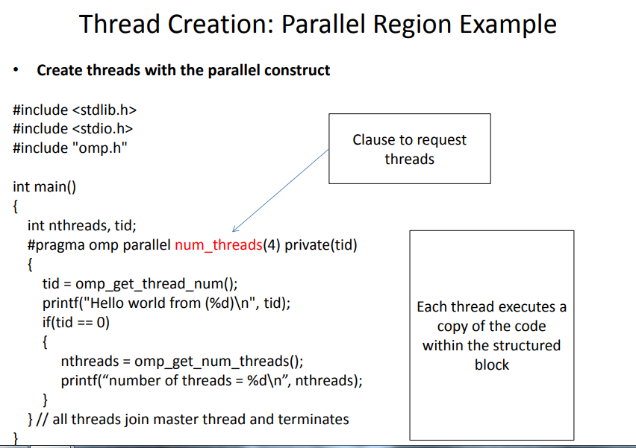

Slide 15
Pros & Cons - OpenMP
Pros of OpenMP-
easier to program and debug than MPI
directives can be added incrementally - gradual parallelization
can still run the program as a serial code
serial code statements usually don't need modification
code is easier to understand and maybe more easily maintained
Incremental parallelism: can work on one part of the program at one time, no dramatic change to code is needed.
Unified code for both serial and parallel applications: OpenMP constructs are treated as comments when sequential compilers are used.
Original (serial) code statements need not, in general, be modified when parallelized with OpenMP. This reduces the chance of inadvertently introducing bugs.
Cons of OpenMP-
can only be run in shared memory computers
requires a compiler that supports OpenMP
mostly used for loop parallelization
High chance of accidentally writing false sharing code.
Notes:
https://www.dartmouth.edu/~rc/classes/intro_mpi/parallel_prog_compare.html
https://en.wikipedia.org/wiki/OpenMP

Slide 16
Performance Expectations
To expect to get a N times speedup when running a program parallelized using an OPENMP on a N processor platform. But its not….rarely it happens as,
When a dependency exists, a process must wait until th data it depends on is computed.
When multiple processes share a non-parallel proof resource (like a file to write in), their requests are executed sequentially. Therefore, each thread must wait until the other thread releases the resource.
A large part of the program may not be parallelized by OpenMP, which means that the theoretical upper limit of speedup is limited.
N processors in a symmetric multiprocessing (SMP) may have N times the computation power, but the memory bandwidth usually does not scale up N times.
Quite often, the original memory path is shared by multiple processors and performance degradation may be observed when they compete for the shared memory bandwidth.
Many other common problems affecting the final speedup in parallel computing also apply to OpenMP, like load balancing and synchronization overhead.
Notes:
https://www.dartmouth.edu/~rc/classes/intro_mpi/parallel_prog_compare.html
https://en.wikipedia.org/wiki/OpenMP

